Slide 1
Parallel Image Processing using OpenMP and Multitasking
Mini project
Subject : parallel programming(bcs702)
Team members
Sandeep S K 4JD22CS092
Niranjan R M 4JD22CS077
Sanjay G M 4JD22CS095
Veeresh G S 4JD22CS118

Slide 2
Introduction
Image processing involves performing operations on images to enhance or extract useful information.
Tasks like grayscale conversion, color inversion, and blurring can be computationally intensive.
Parallel programming allows multiple tasks to run simultaneously on multi-core processors, reducing total processing time.
In this project, we use POSIX threads (pthreads) to apply multiple image filters in parallel.

Slide 3
Objective
This project demonstrates how parallel processing can be achieved using the pthreads library in C. It applies multiple image filters—Grayscale, Invert, and Blur—at the same time by running each filter in a separate thread. This allows all filters to work together efficiently, using multiple CPU cores. The project also compares the execution time of each filter to show how parallelism improves the performance and speed of image processing tasks.

Slide 4
Methodology
Parallel Programming:
-Executing multiple independent tasks concurrently.
Multithreading (pthreads):
-Lightweight threads sharing the same memory space.
STB Image Libraries:
-stb_image.h → For reading image files.
-stb_image_write.h → For saving processed images.

Slide 5
GCC Compiler
System Requirements
Hardware Requirements :
Multi-core CPU (recommended: 2+ cores)
Minimum 4 GB RAM
2. Software Requirements:
Ubuntu (via WSL on Windows)
GCC Compiler
STB image libraries

Slide 6
Algorithm
Load the input image using stbi_load().
Create three threads:
- Thread 1 → Apply Grayscale filter.
- Thread 2 →Apply Invert Filter.
- Thread 3 → Apply Blur Filter.
3. Each thread:
- Processes image pixels independently.
- Saves the result as a new output image.
4. Wait for all threads to finish (pthread_join).
5. Display total time and CPU usage statistics.

Slide 7
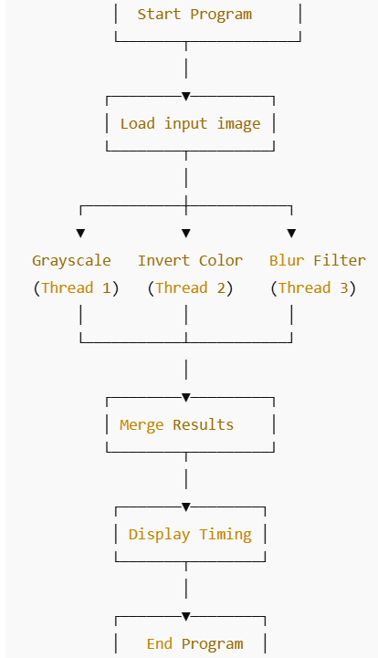
Flowchart

Slide 8
Implementation
Initially we need to install all the Requirements
- GCC compiler
- pthreads (already available on Linux/macOS; use WSL or MinGW on Windows)
- Two single-header libraries from stb:
stb_image.h
stb_image_write.h
👉 Place both files in the same directory as your .c file.

Slide 9
Commands to install the installers:
- wsl –install
- sudo apt update && sudo apt upgrade –y
- sudo apt install build-essential -y
Link to Download the header files:
- https://github.com/nothings/stb

Slide 10
Execution:
Initially check all the files are present in same folder or not.
cd ~/parallelI
mkdir ~/ParallelImageProcessor //make dir command
cd ~/ParallelImageProcessor //change dir command
Ls //list all the files
gcc parallel_image_processor.c -lpthread -lm -o image_processor
//compilation command
./image_processor //Run command

Slide 11

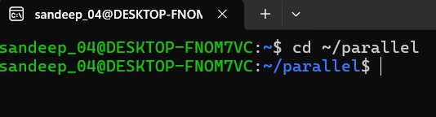
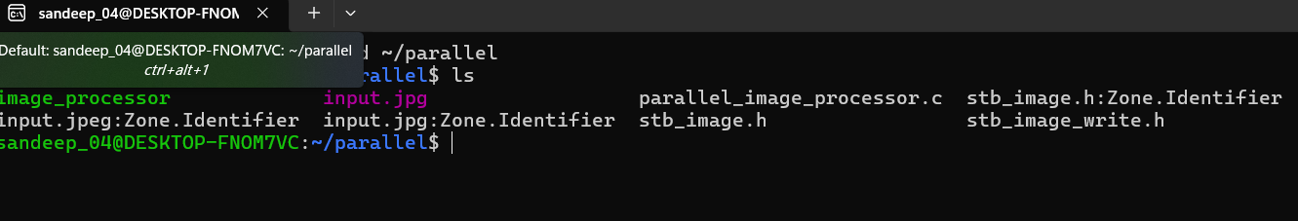
Results
Fig 1.Showing user directory
Fig 2. Changing directory to Project folder
Fig 3.listing all the files in the directory

Slide 12
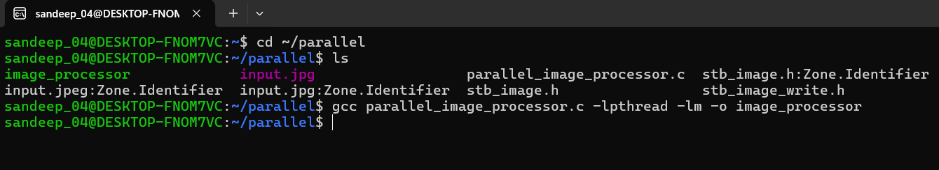
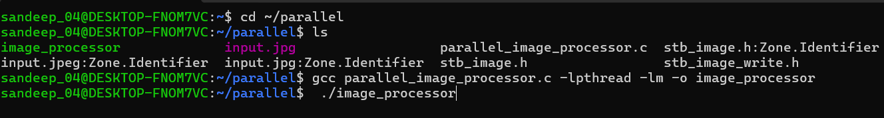
Results
Fig 4.Compiltation of Code
Fig 5. Run Command

Slide 13
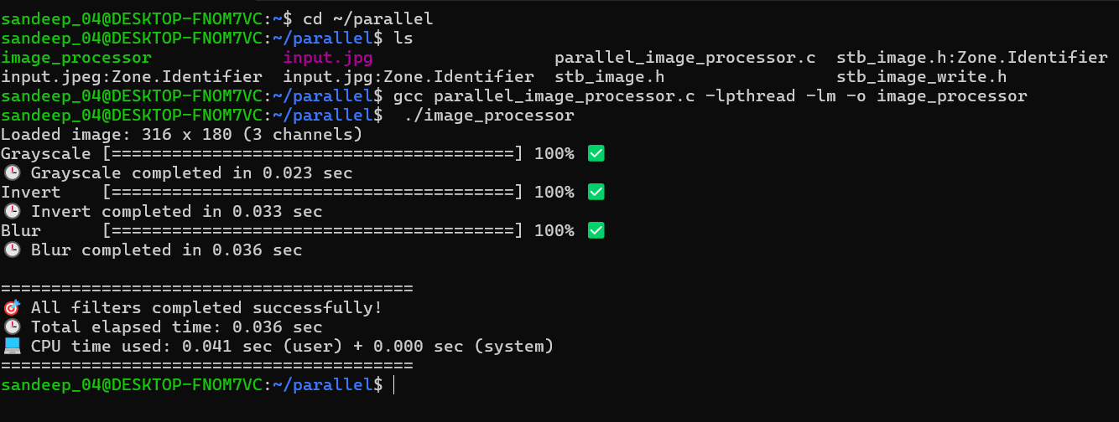
Results
Fig 6.Output of the code

Slide 14
Conclusion
The project successfully implements a Parallel Image Processor using the pthreads library in C, demonstrating significant performance improvements by processing multiple image filters concurrently. Through this implementation, the effectiveness of multithreading in handling computationally intensive image operations has been validated. The project emphasizes the practical application of parallel programming techniques in image analysis, highlighting how concurrent execution can enhance efficiency and reduce processing time in real-world scenarios.

Slide 15


